Slide 1






What is
Human Centered
Data Science?

Slide 2
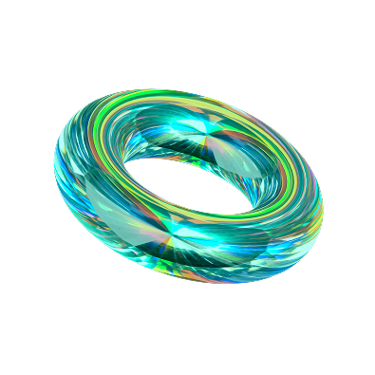


By the end of this class, students will be able to:
Define Human-Centered Data Science
Explain what does “human-centered”
adds to data science
Introduce methods of
Human-Centered Data Science

Slide 3
Myths & Assumptions
about Data Science:
Many assumptions are made about data science, its potential to improve people’s lives and to shape a more automated and fair future.
Algorithms and data are assumed to be neutral and unbiased.
Removing humans is assumed to remove bias and error.

Slide 4
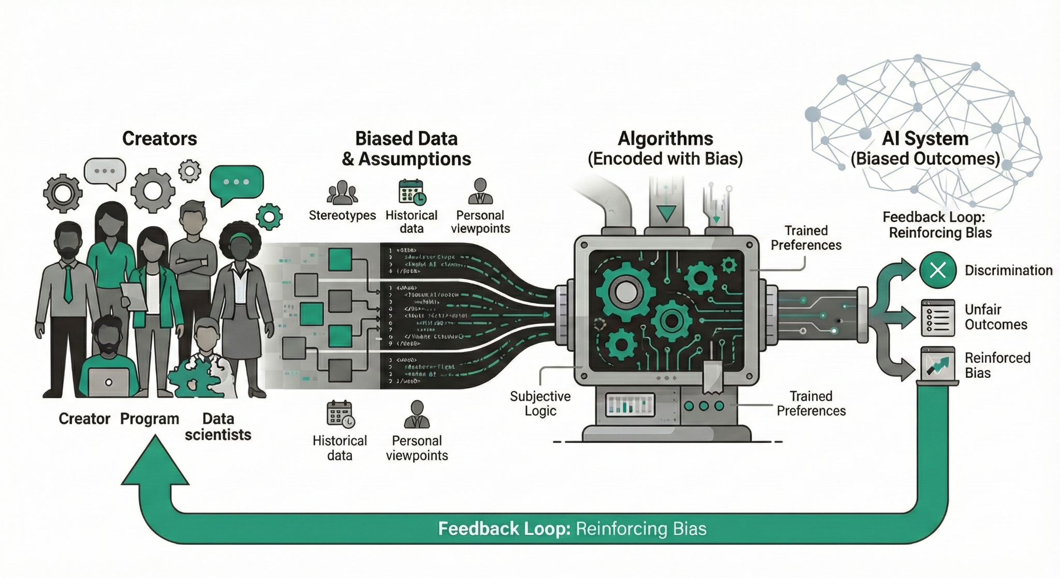
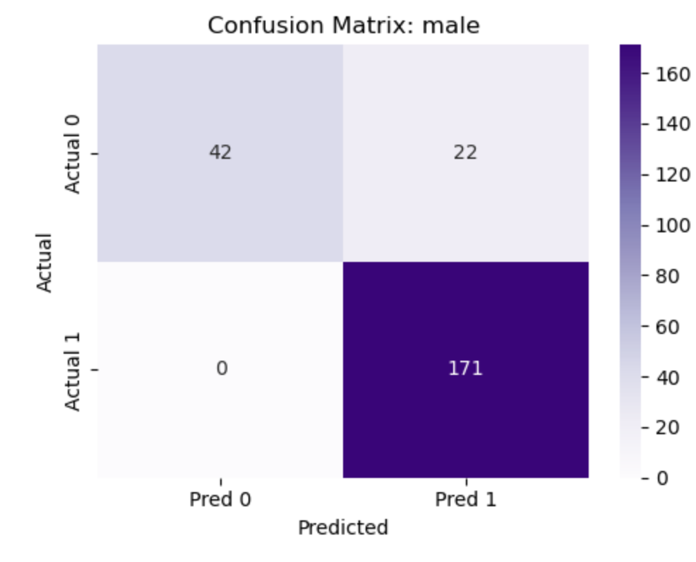
Algorithms &
Data Science Realities
Data, and algorithms are encoded with bias from those who create them.
Algorithms include societal bias and can encode them into data structures and systems
Training data are by their very nature biased, the hidden nature of this bias makes it insidious.

Slide 5
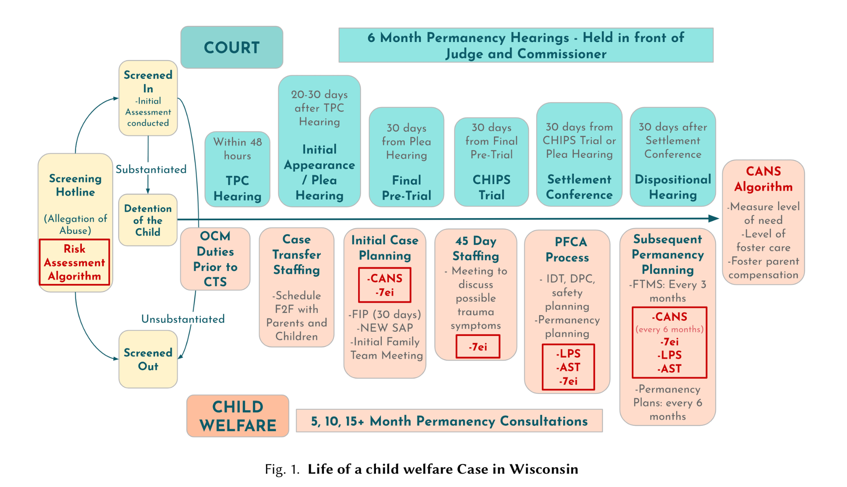
Algorithmic Screening
in Child Welfare
Child welfare agencies use algorithms to flag which hotline calls should be investigated.
The model can encode and amplify existing racial and socioeconomic inequalities.
Human workers, institutional policy, and data all shape how ‘risk’ is defined and acted on.

Slide 6



Addressing
Algorithmic Bias
Clearly define the purpose of their algorithms.
Identify potential harm to individuals or groups.
Recognize long-term, downstream consequences of the algorithm's deployment.
To effectively address and prevent algorithmic bias like the child welfare example data scientists must:
Notes:
Purpose: what is the model actually for? Triage? Predicting harm? Managing caseloads?
Harm: whose false positives/negatives matter?
Downstream: how might this affect families in 5–10 years?

Slide 7
Addressing Data Bias
Recognize who is included and who is missing from the data.
Think about:
How was the data collected
How will the data be used
Human-Centered Review of Algorithms used within the U.S. Child Welfare System. Saxena et al. - CHI 2020
Used clear requirements for what data was collected:
-Explicitly used papers that were peer reviewed or government agency reports
-Only used papers or reports that discussed computational methods, predictors and outcomes

Slide 8

Activity 1
Turn to someone next to you and discuss a time when a social media algorithm presented you with content that seemed unrelated to your usual user behaviour and what may have contributed to this recommendation.

Slide 9
Defining Human-Centered
Data Science
A multidisciplinary field of study that rejects the notion that automated or computational approaches are “free” of bias, and recognizes:
Complex interactions between society and technology
All data is produced collected, or interpreted by people
Increasingly data is being generated by AI that depends on human prompts

Slide 10
Purpose of Human-Centered
Data Science
Big Data’s Disparate Impact. Barocas & Selbst - 2016
St. George’s Hospital in the UK created a computer program to accept medical school applicants:
-Trained on prior data, which had patterns of rejection for women/racial minorities with the same qualifications as accepted white men
-Replicated prejudice against women and racial minorities
-This was not coded in the algorithm but was in the data, the program replicated the bias
Systematically foregrounds human impacts in all stages of data science.
Shifting the lens from what is possible to is it a net benefit to those impacted
Addresses the social impact of large-scale data practices.

Slide 11



Centering Humans in Data Science
Understand human and social contexts; respond ethically to the problems being addressed.
Go beyond just usability and asks about impact
Seek to develop empathy for those impacted by data science.

Slide 12
Why center humans?
There is growing concern around data science being so harmful that it does not meaningfully succeed in its goals of creating a better future.
Quick Reflection
Do you think that data science can make a better future for everyone? Why or why not?
Have your thoughts on this changed? Why or why not?

Slide 13
Human-Centered Data Science Objectives
Build rigorous and ethical algorithms
Focus on the people involved in data science at every level.
What does it mean to meaningfully reflect on the responsibility that comes with the possibilities of data science?
Is the act of reflection alone enough to guard against potential harms?

Slide 14
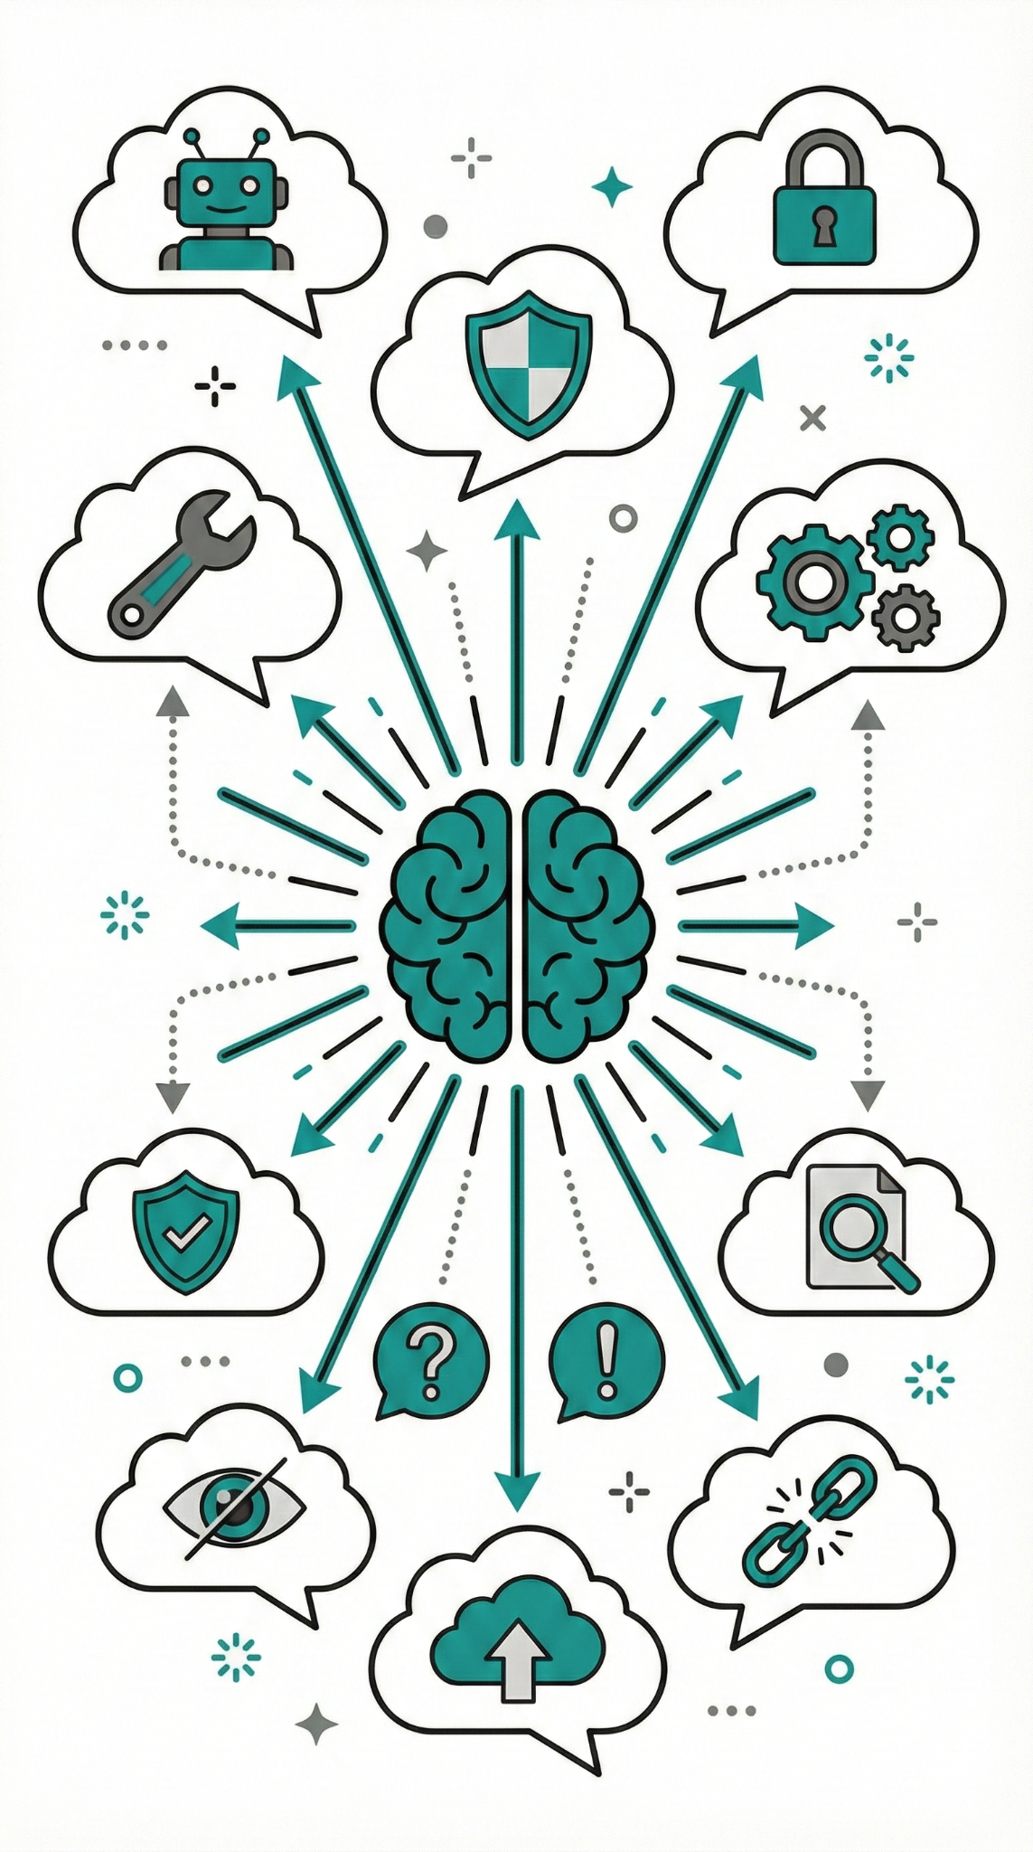
Activity 2
Turn to someone next to you and brainstorm an example of when privacy was not considered (or poorly considered) in the building of an AI tool?
Whose privacy should have been considered? How could it be appropriately considered in the future?
Notes:
Image from: https://www.pexels.com/photo/black-android-smartphone-on-top-of-white-book-39584/

Slide 15
Methods
Human-centered data science recenters the humans involved at every stage in the data science life cycle.
Conducting qualitative research, including data collection and data analysis, that focuses on studying the people who produce data sets, algorithms, run data analysis, and interpret results.
Using design methods including participatory design, speculative design, and human centered design.
“This is not a data problem”: Algorithms and Power in Public Higher Education in Canada. McConvey & Guha - CHI2024
Looked at higher education use of algorithms:
-Gathered contextual data about how decisions about student data were made
-Interviewed individuals across the institution
-Reviewed existing datasets and reports

Slide 16

Human-Centered Data Science
as ethical responsibility
Work responsibly, treating everyone affected with care.
Each step of data science relies on assumptions at best and bias at worst
Methods to detect and mitigate bias will evolve over time
Example/Question
Large scale data presents challenges to rights and privacy, even innocuous data can quickly become identifiable

Slide 17

Human-centered Data Science
is looking in the right places
Framing the right questions and looking for their answers in the right places
Don’t just look for a convenient answer
Select the best data to evaluate these problems
Example/Question
Social media with accessible API’s can make it easy to aggregate “perception” but may not be the best place to look for this information
Where else might you look if you want to include people who are not active on social media?

Slide 18

Human-Centered Data Science
as collective practice
When we think together, we are more powerful than when we think alone.
Working with domain experts is key to doing human centered data science
Data science is collaborative and should include all stakeholders
Example/Question
Who is a part of a data team and who is affected but not represented?

Slide 19

Human-Centered Data Science
as communication
How we communicate these findings is central to ethical and responsible data science.
Data science can be storytelling
Good data science is collaborative and relies on good communication across a data team
Example/Question
Covid-19 Data Visualizations on Social Media
Misleading through context and narrative
Line chart that is lacking causation relationship is contextualized as such when posted
Design influences perception
Lack of sample size or uncertainty on charts can create misleading charts
Viewer interpretation bias
Purposeful misuse of charts to mislead others using charts with missing bias to invert what they show to support misinformation

Slide 20

Human-Centered Data Science
as action
We must be clear in what benefits and what harms these systems create.
These systems can create winners and losers
Data science systems can have life altering impacts
Example/Question
Who benefits? Who is harmed? Whose side are you effectively on with this system?

Slide 21
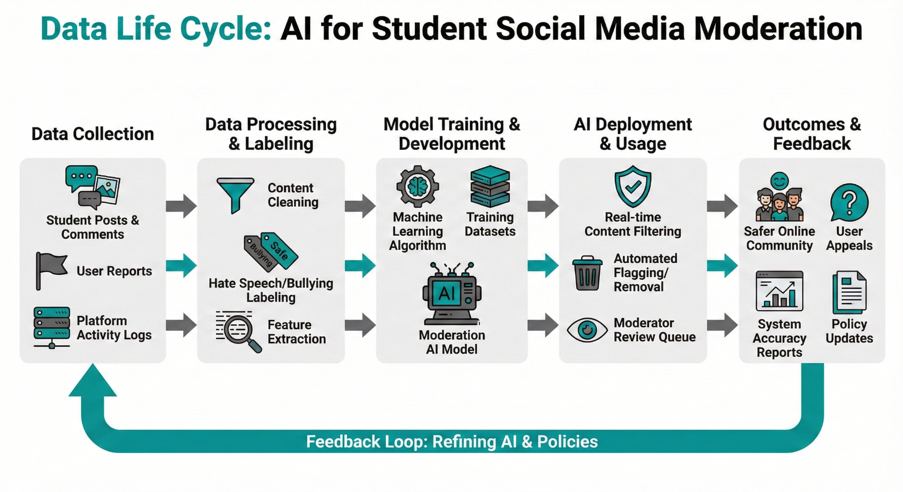
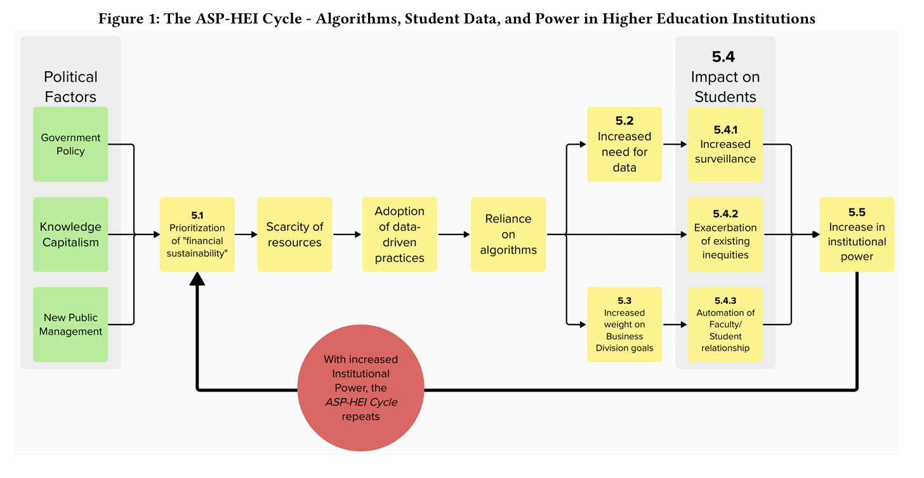
Activity 3: Group Exit Ticket
As a small group create a flow diagram of the people across the data life cycle, may be helpful to use a specific data scenario for this activity
(e.g. Mortgage application algorithms, AI for job applications, Ai for rental apps)
Think about the data itself:
Who is transforming the data?
Who is impacted after algorithms are created?
What are the potential long-term benefits or harms?
Notes:
Time budget (20+ minutes), on the way ‘out the door’.
Debrief with students the following class by providing 2-3 examples.
Suggest collecting and sharing anonymized diagrams back to the class after each lecture for peer-to-peer learning. Instructor can assemble all group exit tickets at the conclusion of the semester as a student-generated debrief of the entire course.

Slide 22
Credits and References
Instructor Facing
Barocas, S. and Selbst, A. D. 2016. Big Data’s Disparate Impact. 104 California Law Review, 671–732. https://doi.org/10.2139/ssrn.2477899
Lisnic, M., Polychronis, C., Lex, A., and Kogan, M. 2023. Misleading Beyond Visual Tricks: How People Actually Lie with Charts. In Proceedings of the 2023 CHI Conference on Human Factors in Computing Systems (CHI ’23), April 23–28, 2023, Hamburg, Germany. ACM, New York, NY, USA, 1–21. https://doi.org/10.1145/3544548.3580910
McConvey, K. and Guha, S. 2024. “This is not a data problem”: Algorithms and Power in Public Higher Education in Canada. In Proceedings of the 2024 CHI Conference on Human Factors in Computing Systems (CHI ’24). Association for Computing Machinery, New York, NY, USA, Article 16, 1–14. https://doi.org/10.1145/3613904.3642451
Saxena, D., Badillo-Urquiola, K., Wisniewski, P. J., and Guha, S. 2020. A Human-Centered Review of Algorithms used within the U.S. Child Welfare System. In Proceedings of the 2020 CHI Conference on Human Factors in Computing Systems (CHI '20). Association for Computing Machinery, New York, NY, USA, 1–15. https://doi.org/10.1145/3313831.3376229

